Slide 1



‏‏project - עותק
View in Power BI
Last data refresh:
6/10/2025 12:27:46 PM UTC
Downloaded at:
6/30/2025 3:55:39 AM UTC

Slide 2
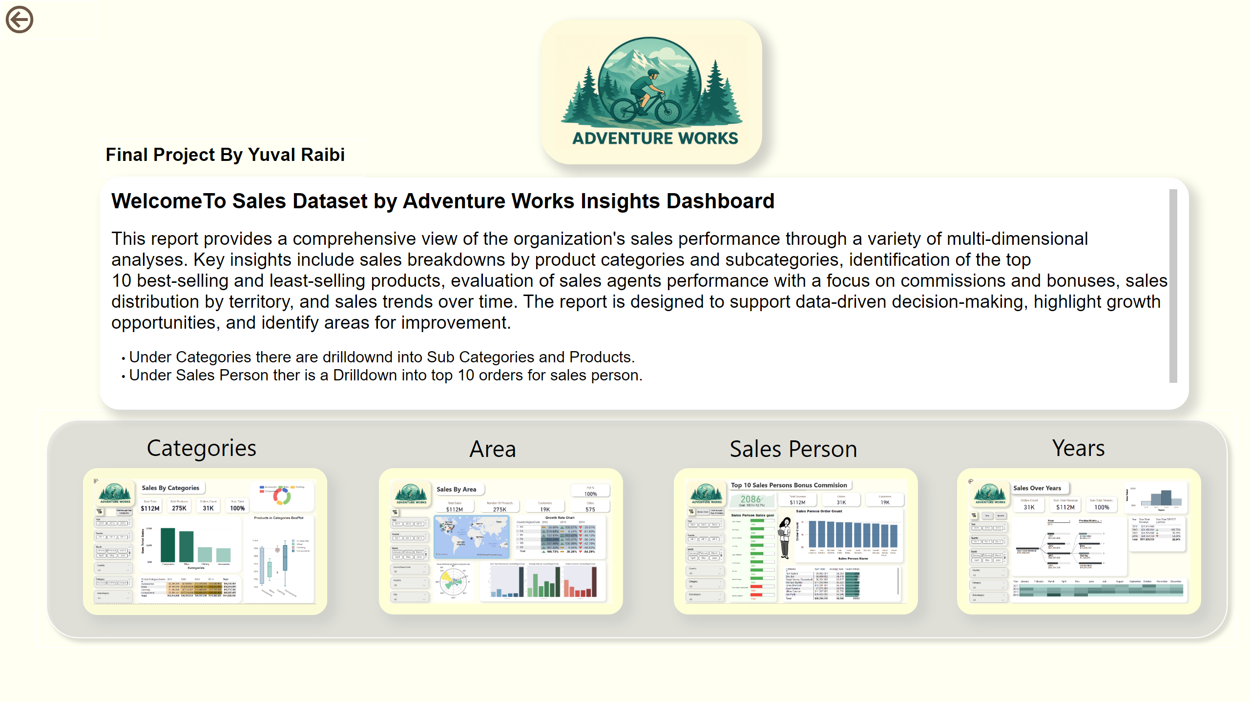
Home Page
Notes:
actionButton
No alt text provided
ChicletSlicer1448559807354
No alt text provided
image
No alt text provided
shape
No alt text provided
shape
No alt text provided
shape
No alt text provided
shape
No alt text provided
shape
No alt text provided
textbox
No alt text provided
image
No alt text provided
image
No alt text provided
image
No alt text provided
image
No alt text provided
textbox
No alt text provided

Slide 3
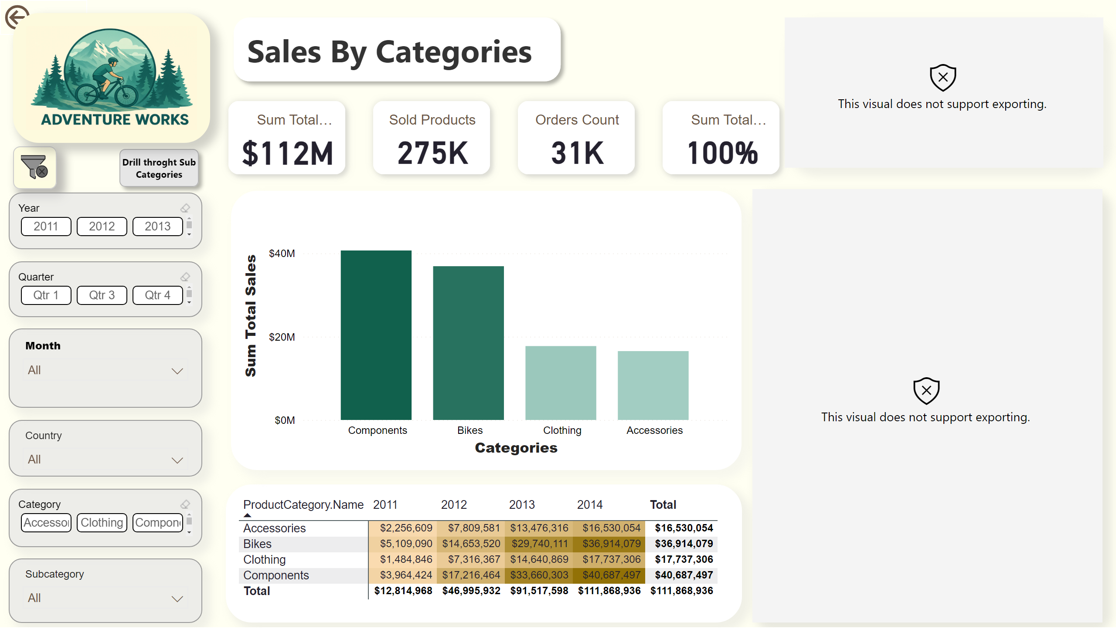
Sales By Category
Notes:
image
No alt text provided
actionButton
No alt text provided
slicer
No alt text provided
ChicletSlicer1448559807354
No alt text provided
slicer
No alt text provided
slicer
No alt text provided
ChicletSlicer1448559807354
No alt text provided
ChicletSlicer1448559807354
No alt text provided
pivotTable
No alt text provided
shape
No alt text provided
cardVisual
No alt text provided
pie050B4EA6F32774BA1AFDC6E3E005A3168
No alt text provided
lineClusteredColumnComboChart
No alt text provided
shape
No alt text provided
ChicletSlicer1448559807354
No alt text provided
image
No alt text provided
Products in Categories BoxPlot
No alt text provided

Slide 4
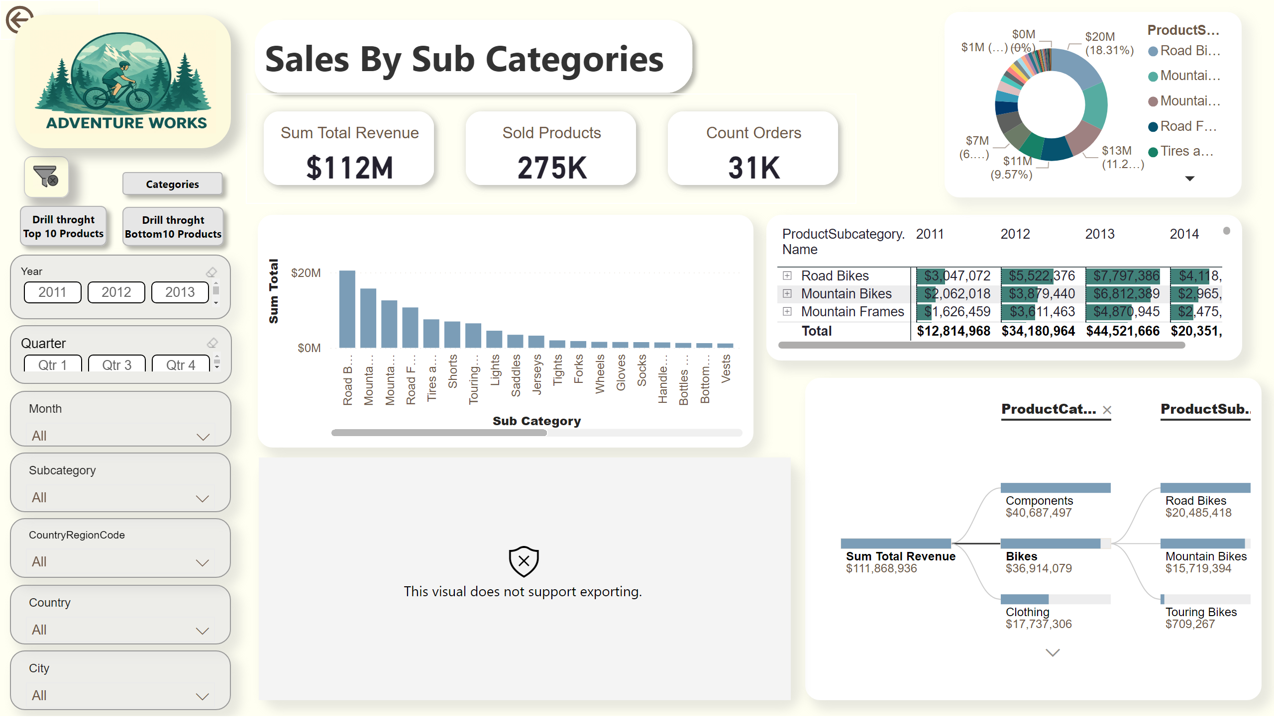
Drillthrough of Sales By SubCategory
Notes:
actionButton
No alt text provided
shape
No alt text provided
cardVisual
No alt text provided
lineClusteredColumnComboChart
No alt text provided
pivotTable
No alt text provided
decompositionTreeVisual
No alt text provided
donutChart
No alt text provided
ChicletSlicer1448559807354
No alt text provided
ChicletSlicer1448559807354
No alt text provided
slicer
No alt text provided
slicer
No alt text provided
slicer
No alt text provided
slicer
No alt text provided
slicer
No alt text provided
image
No alt text provided
image
No alt text provided
Order Count Over years for SubCategory
No alt text provided
shape
No alt text provided
shape
No alt text provided
shape
No alt text provided
ChicletSlicer1448559807354
No alt text provided
ChicletSlicer1448559807354
No alt text provided

Slide 5
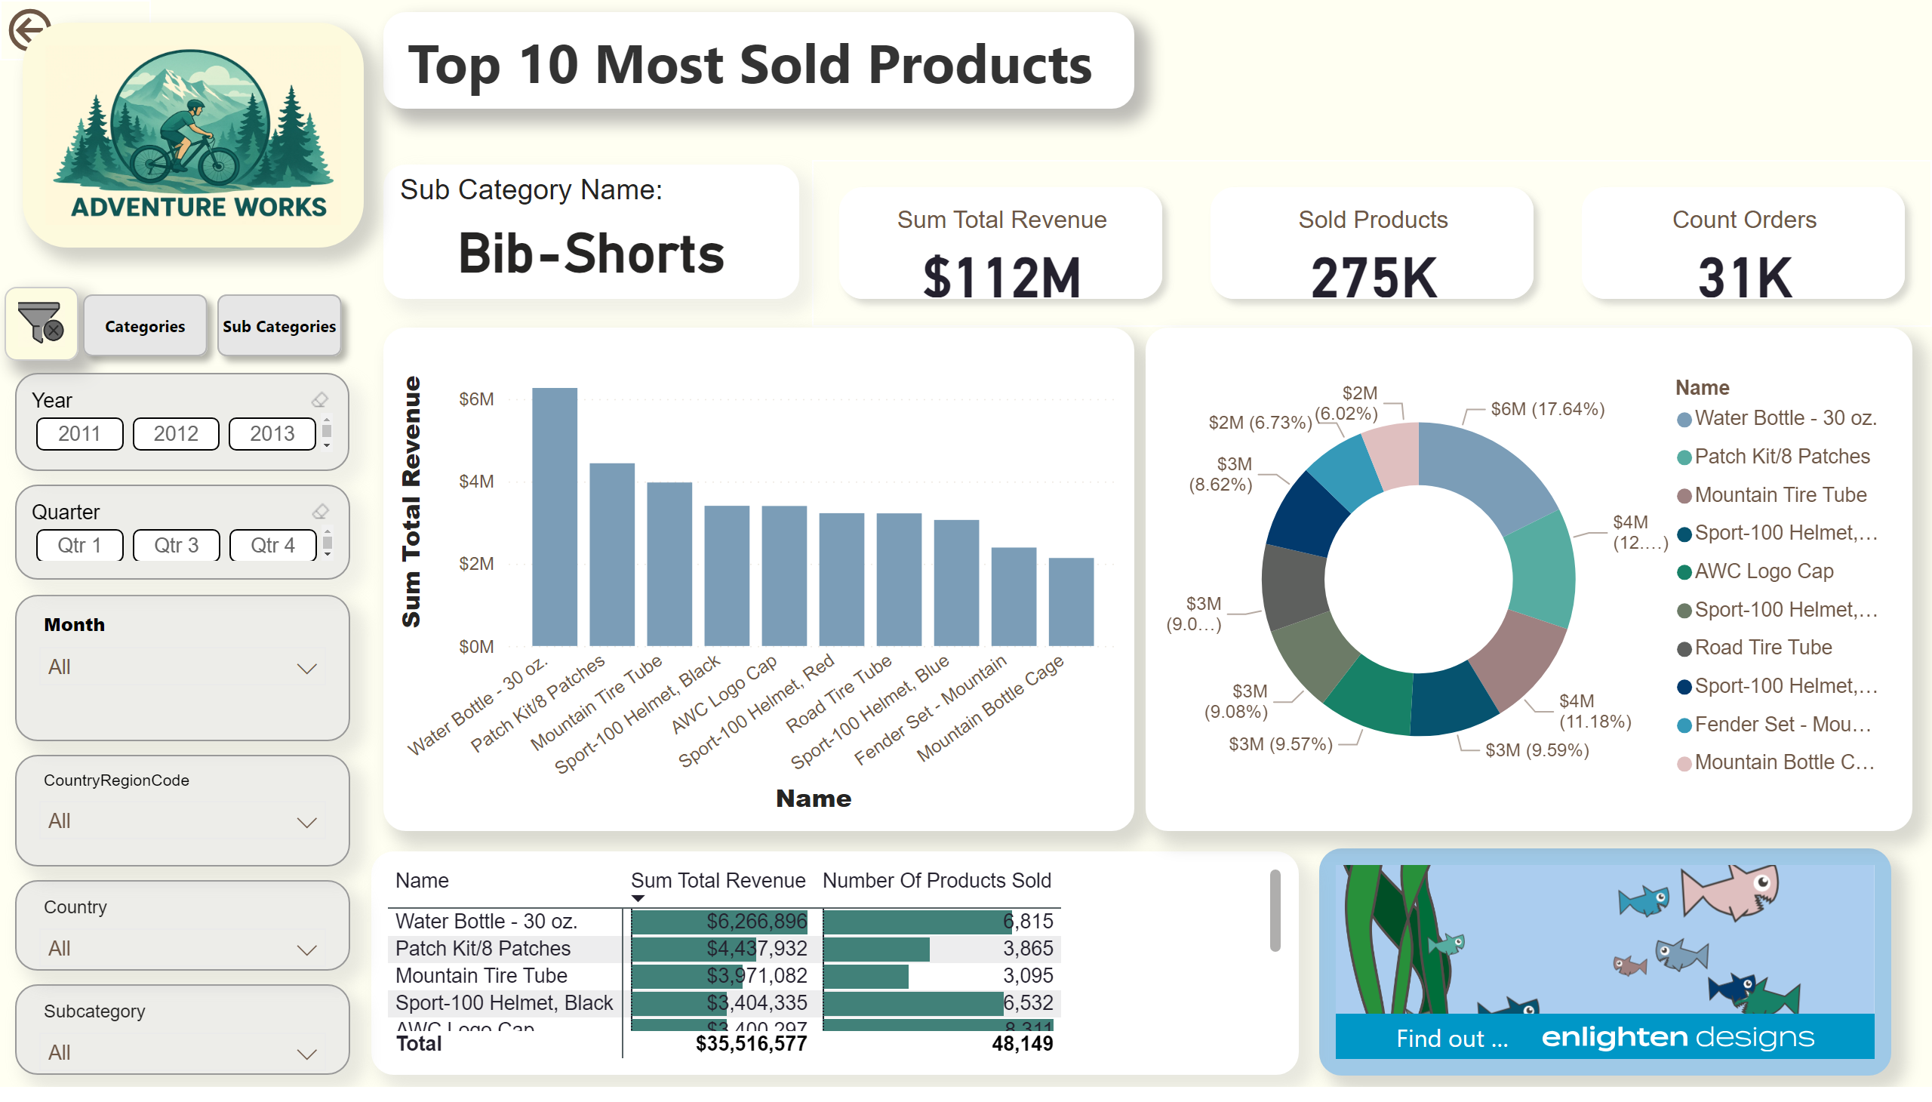
Drillthrough of Top 10 Products
Notes:
Sub Category Name:
No alt text provided
image
No alt text provided
slicer
No alt text provided
slicer
No alt text provided
ChicletSlicer1448559807354
No alt text provided
shape
No alt text provided
shape
No alt text provided
image
No alt text provided
ChicletSlicer1448559807354
No alt text provided
ChicletSlicer1448559807354
No alt text provided
slicer
No alt text provided
slicer
No alt text provided
donutChart
No alt text provided
pivotTable
No alt text provided
lineClusteredColumnComboChart
No alt text provided
Aquarium1442671919391
No alt text provided
cardVisual
No alt text provided
shape
No alt text provided
actionButton
No alt text provided

Slide 6
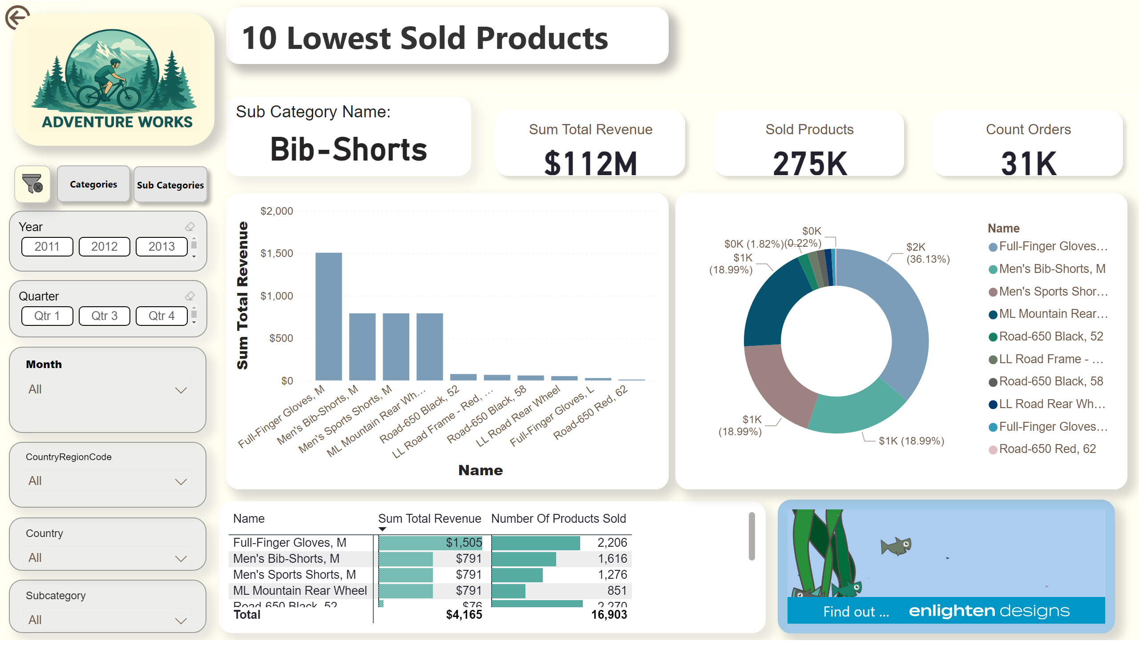
Drillthrough of 10 Lowest Products
Notes:
actionButton
No alt text provided
shape
No alt text provided
cardVisual
No alt text provided
Aquarium1442671919391
No alt text provided
lineClusteredColumnComboChart
No alt text provided
pivotTable
No alt text provided
donutChart
No alt text provided
Sub Category Name:
No alt text provided
image
No alt text provided
ChicletSlicer1448559807354
No alt text provided
ChicletSlicer1448559807354
No alt text provided
slicer
No alt text provided
slicer
No alt text provided
slicer
No alt text provided
slicer
No alt text provided
image
No alt text provided
shape
No alt text provided
shape
No alt text provided
ChicletSlicer1448559807354
No alt text provided

Slide 7
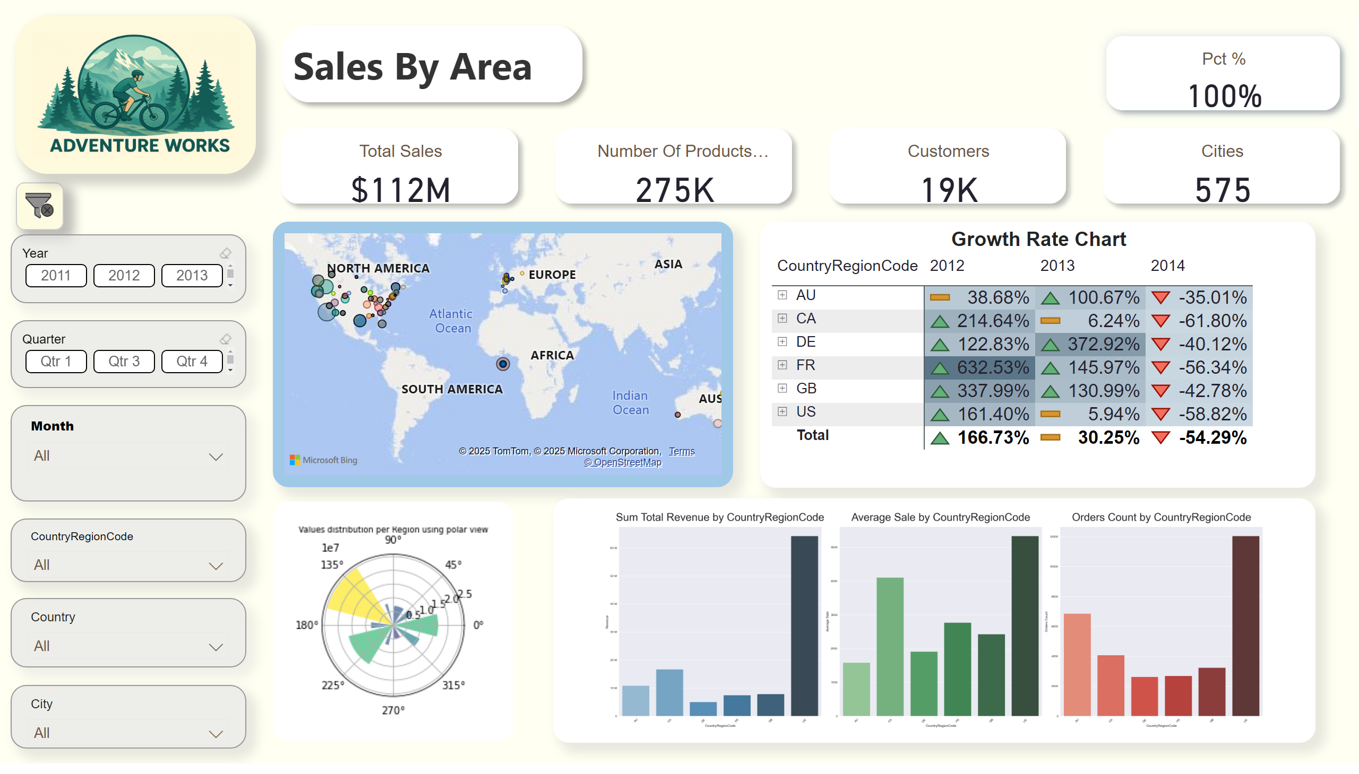
Sales By Area
Notes:
map
No alt text provided
shape
No alt text provided
cardVisual
No alt text provided
image
No alt text provided
slicer
No alt text provided
slicer
No alt text provided
slicer
No alt text provided
slicer
No alt text provided
ChicletSlicer1448559807354
No alt text provided
ChicletSlicer1448559807354
No alt text provided
image
No alt text provided
cardVisual
No alt text provided
Growth Rate Chart
No alt text provided
pythonVisual
No alt text provided
pythonVisual
No alt text provided

Slide 8
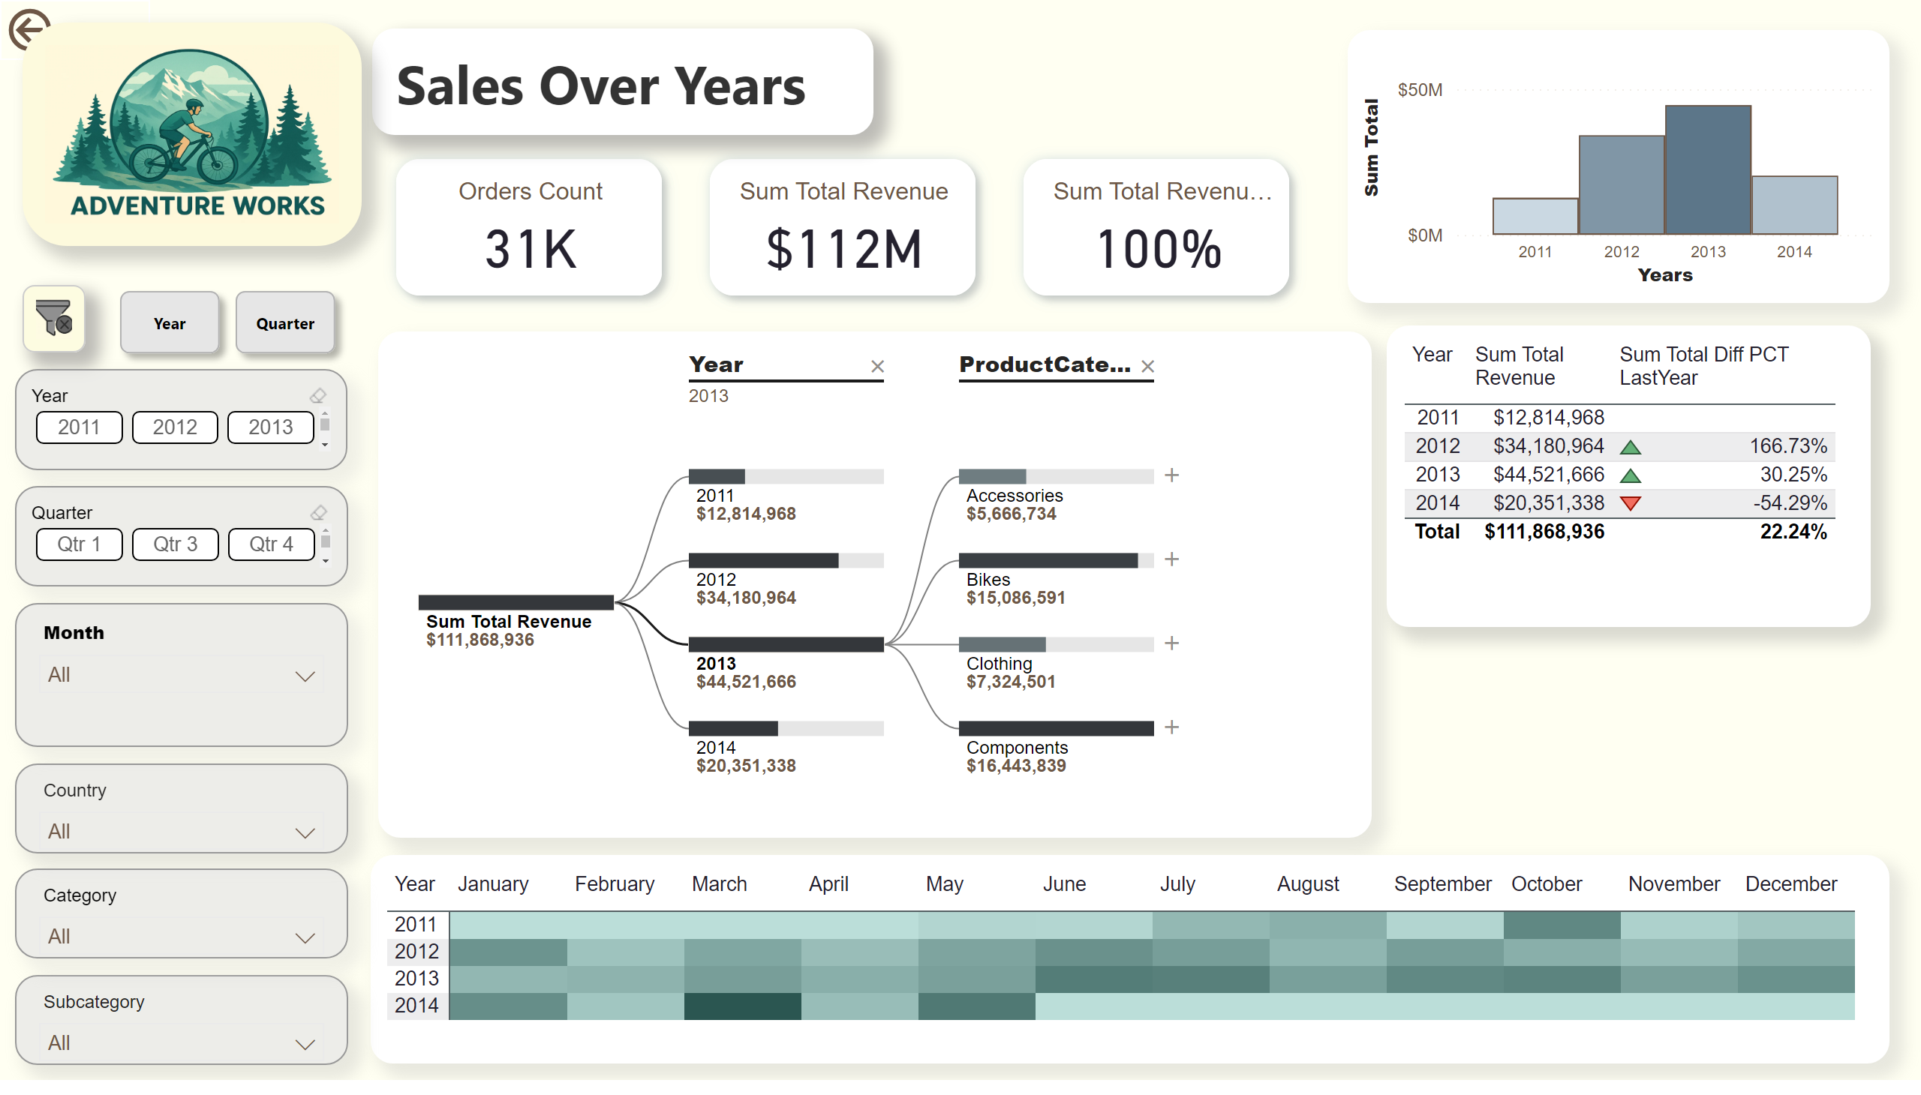
Sales Over Years
Notes:
cardVisual
No alt text provided
shape
No alt text provided
decompositionTreeVisual
No alt text provided
actionButton
No alt text provided
lineClusteredColumnComboChart
No alt text provided
pivotTable
No alt text provided
pivotTable
No alt text provided
decompositionTreeVisual
No alt text provided
lineClusteredColumnComboChart
No alt text provided
image
No alt text provided
ChicletSlicer1448559807354
No alt text provided
ChicletSlicer1448559807354
No alt text provided
slicer
No alt text provided
slicer
No alt text provided
slicer
No alt text provided
slicer
No alt text provided
image
No alt text provided
tableEx
No alt text provided
tableEx
No alt text provided
shape
No alt text provided
shape
No alt text provided
shape
No alt text provided

Slide 9
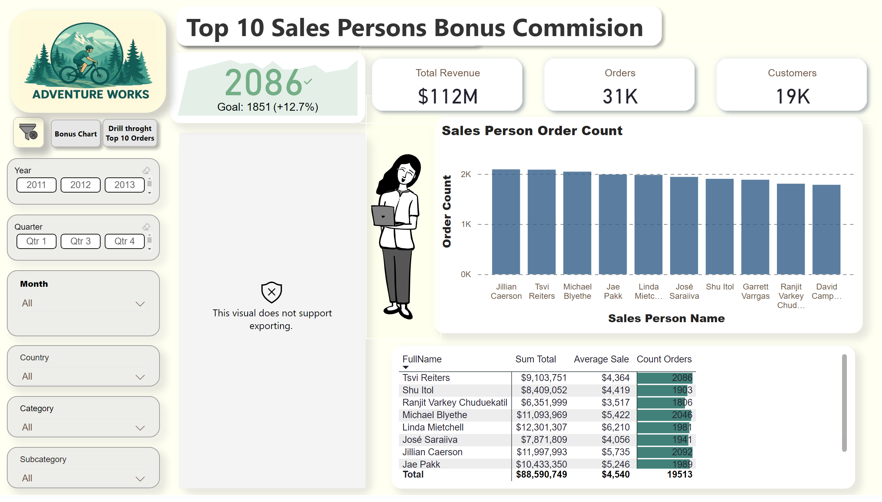
Sales By Sales Person
Notes:
pivotTable
No alt text provided
Sales Person Sales goal
No alt text provided
kpi
No alt text provided
shape
No alt text provided
Sales Person Order Count
No alt text provided
comicgen1058F16C30B888F41E2AE146D059FD5ACEE
No alt text provided
cardVisual
No alt text provided
pivotTable
No alt text provided
clusteredColumnChart
No alt text provided
cardVisual
No alt text provided
ChicletSlicer1448559807354
No alt text provided
ChicletSlicer1448559807354
No alt text provided
slicer
No alt text provided
slicer
No alt text provided
slicer
No alt text provided
slicer
No alt text provided
image
No alt text provided
databarKPIB8060E2B144244C5A38807466893C9F5
No alt text provided
kpi
No alt text provided
image
No alt text provided
shape
No alt text provided
shape
No alt text provided
shape
No alt text provided

Slide 10
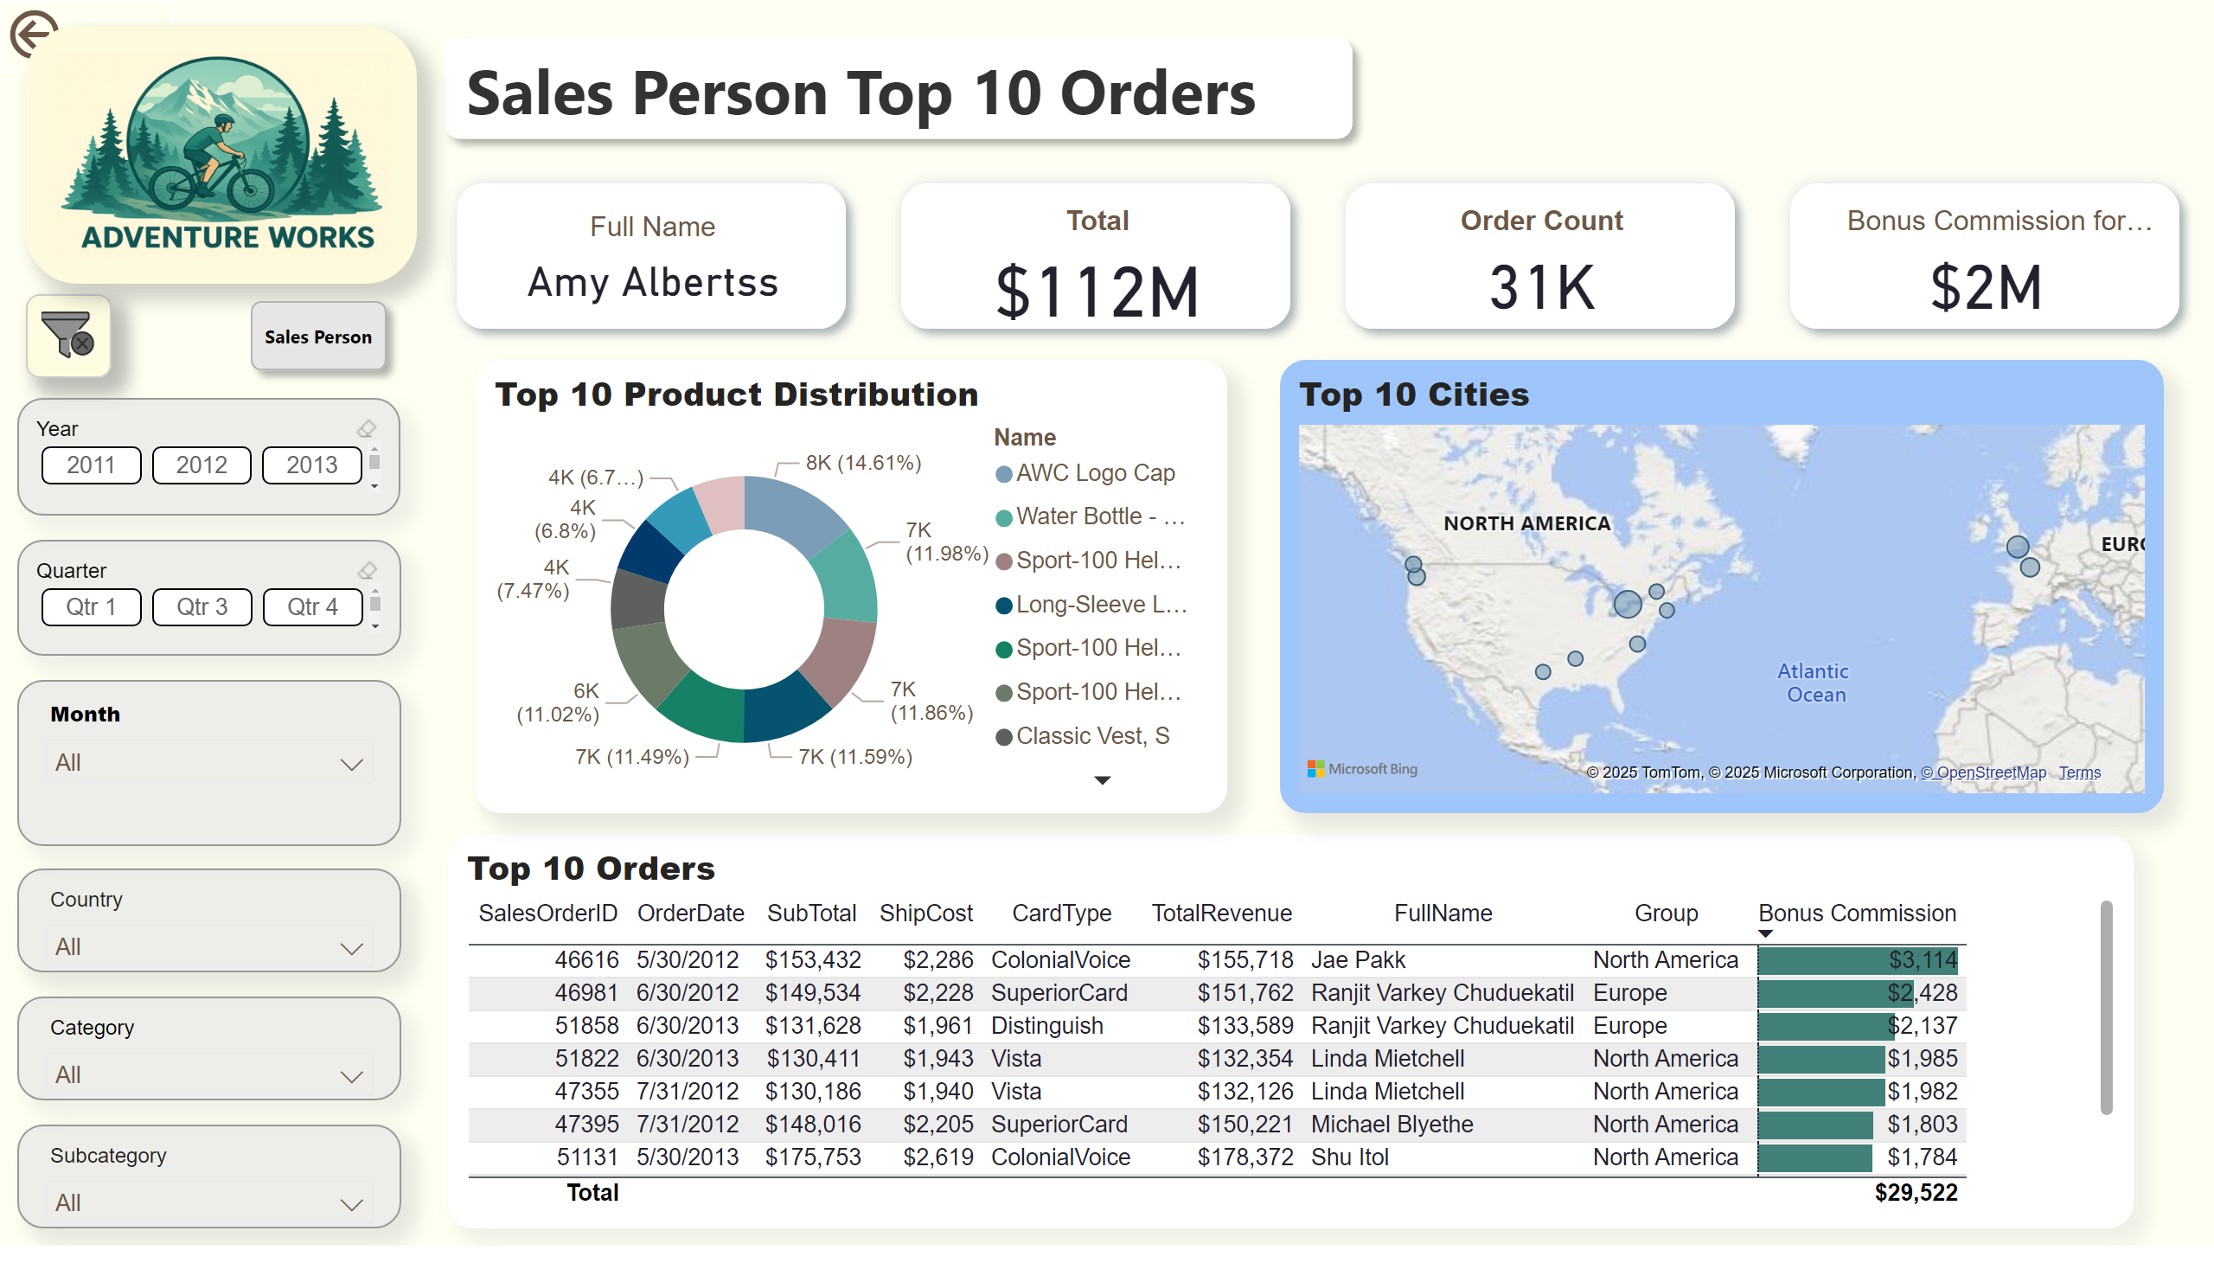
Drilltrought of Sales Person Top 10 orders
Notes:
cardVisual
No alt text provided
Top 10 Orders
No alt text provided
actionButton
No alt text provided
Top 10 Product Distribution
No alt text provided
Top 10 Cities
No alt text provided
shape
No alt text provided
ChicletSlicer1448559807354
No alt text provided
ChicletSlicer1448559807354
No alt text provided
slicer
No alt text provided
slicer
No alt text provided
slicer
No alt text provided
slicer
No alt text provided
image
No alt text provided
image
No alt text provided
shape
No alt text provided

